Slide 1
OpenCV와 YOLO를 활용한 불법 차선 변경 감지 시스템
Trailblazer
2020069049 이진희
2019068050 나동규

Slide 2
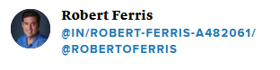

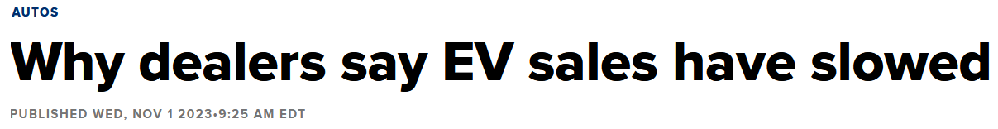
Source: https://www.cnbc.com/2023/11/01/why-dealers-say-ev-sales-have-slowed.html

Slide 3
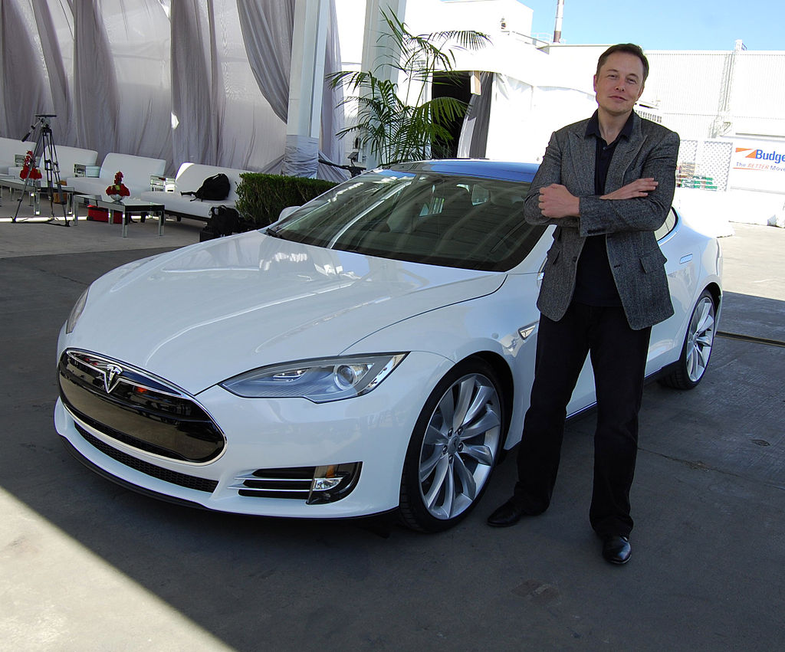

Slide 4
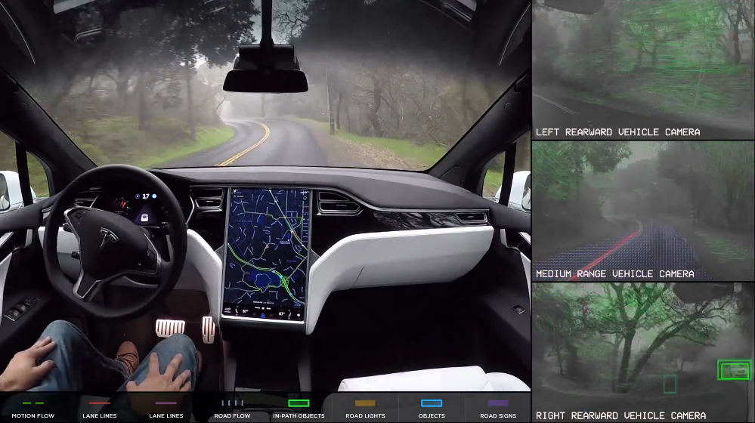

Slide 5
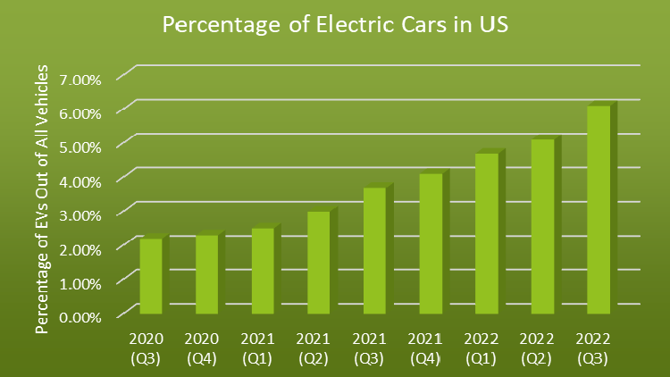
미국 내 전기 자동차 비율
Source: https://8billiontrees.com/carbon-offsets-credits/cars/how-many-electric-cars-in-the-us/

Slide 6
차량 차선 변경 탐지
번호판 모자이크
대화 음소거

Slide 7
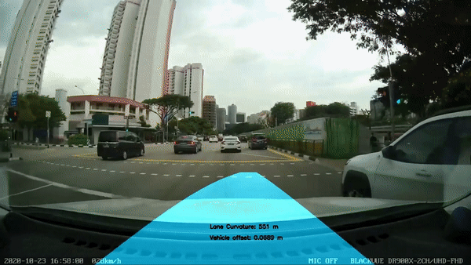
Lane Detection
Source: https://github.com/kemfic/Curved-Lane-Lines

Slide 8
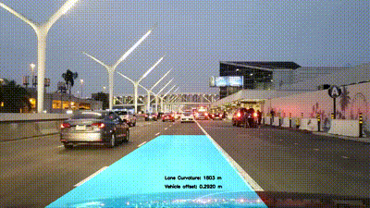
Lane Detection
Source: https://github.com/kemfic/Curved-Lane-Lines

Slide 9
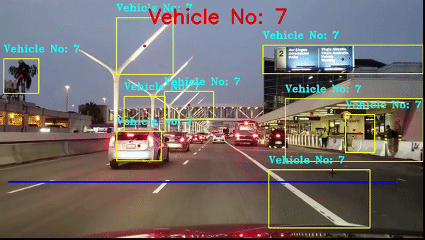
Vehicle Detection
Source: https://github.com/mathuraman14/Vehicle-detection

Slide 10
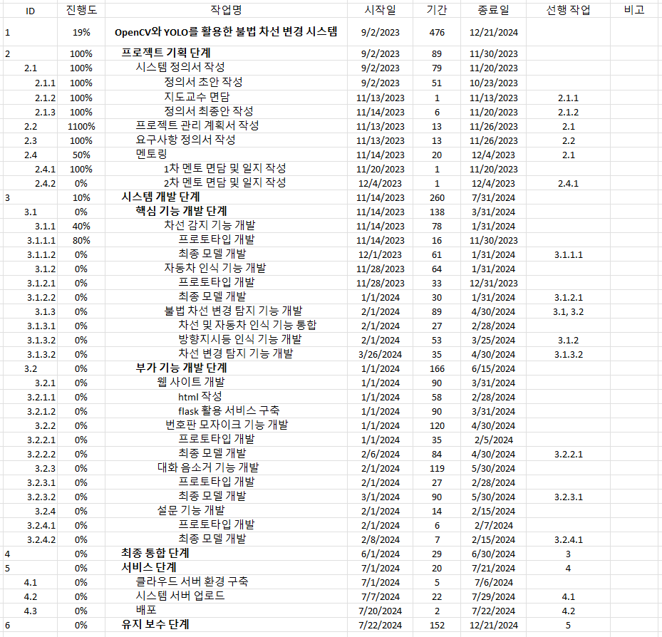
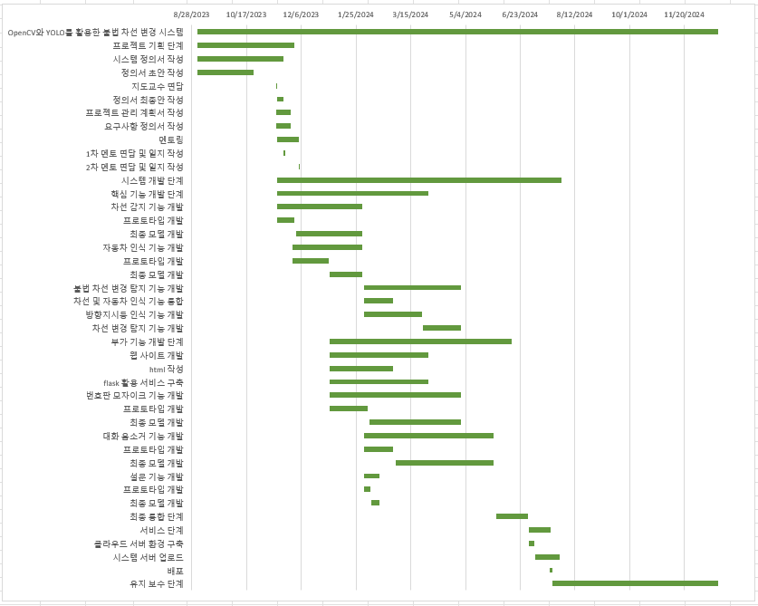

Slide 11
Q&A

